Slide 1


教师说课PPT

Slide 2



1 教材分析
2 学情分析
3 教学理念
4 教学方法
5 教学过程
教学反思

Slide 3



教学重点
教学难点
More than 50% of your traffic comes from social media platforms. So how do you go about executing a content strategy AND keep track of what’s trending?
Here are a few tools to make the going easy…
高龄游客的特征
如何灵活提供服务
Notes:
更多模版：亮亮图文旗舰店https://liangliangtuwen.tmall.com

Slide 4


教学目标!
01
03
知识目标
02
情感目标
Click here to add your text. Click here to add your text. Click here to add your text.
能力目标
Click here to add your text. Click here to add your text. Click here to add your text.
Click here to add your text. Click here to add your text. Click here to add your text.

Slide 5



学情 分析
1.学生原有的基础
2.学生先学的基础
3.学生的关注点
单击此处添加您的标题文字单击此处添加您的标题文字单击
单击此处添加您的标题文字单击此处添加您的标题文字单击
单击此处添加您的标题文字单击此处添加您的标题文字单击

Slide 6

“后茶馆式” 教学!
一种关注学生学习获得知识的方法过程，提高学生学习效能的教学方式

Slide 7

教育指导 思想?
陶行知:知识来源于实践。
陶行知认识论：
行（实践）
知（知识）
行（实践）
Notes:
更多模版：亮亮图文旗舰店https://liangliangtuwen.tmall.com

Slide 8

教学 教法
If not literally, at least to some extent! Try and get real time reviews on your products/services. Ask questions about what your customers expect next and try to fit some of those suggestions into your work. This helps establish a rapport and shows you off as being customer driven. After all, this is exactly what people look for - to be heard!更多模版：亮亮图文旗舰店https://liangliangtuwen.tmall.com
Notes:
更多模版：亮亮图文旗舰店https://liangliangtuwen.tmall.com

Slide 9
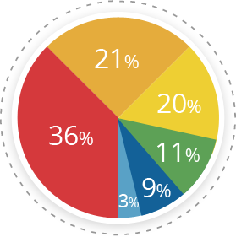
教学 过程
5分钟..........合理安排，分解目标
20分钟..........精确定位，明确目标
18分钟...........处方教学
2分钟...........布置作业
Producing a Variety of Content..........9%
No Answer............................................3%

Slide 10
第一节课 合理安排，分解目标
课前
课上
Don’t always go for an all season look, get a makeover based on climate, festivities, etc; it gives a human touch to your business.
A human business is more relatable than one that sounds also robotic and only sales oriented.
If overhauling the website every time isn’t a feasible option; opt for changing the looks of your social profiles.
For example, bring some variation in your cover pictures on Facebook if you feel like keeping the profile picture constant to your business logo.

Slide 11
第一节课 合理安排，分解目标
导学卡：
1 基本内容
2 遵循原则
3 使用方式
4 指导思想更多模版：亮亮图文旗舰店https://liangliangtuwen.tmall.com
Notes:
更多模版：亮亮图文旗舰店https://liangliangtuwen.tmall.com

Slide 12

第一节课 合理安排，分解目标
课堂随想：
现代心理学研究认为，合作学习是最佳的学习方式，学生在合作中交流，交流中形成合作的意识

Slide 13

第二节课 精确定位，明确目标
案例分析：
人们在生产生活当中所经历的典型的富有多种意义的事件陈述。

Slide 14

第二节课 精确定位，明确目标
教学 过程
一、案例关键点
..because in a world where we have access to unlimited information in a matter of seconds, information based marketing has become vital.

Slide 15

第二节课 精确定位，明确目标
二、创设情景、导出难点
Its a social media tool that not just focuses on presenting you with what’s trending in your circles, but also helps you with CRM.
It offers you insights on the popularity of your business
设计意图：
is by far the most popular tool in the market.
Notes:
更多模版：亮亮图文旗舰店https://liangliangtuwen.tmall.com

Slide 16
第二节课 精确定位，明确目标
三、教师师范，学生点评
No one has the time to go through text heavy posts; but who doesn’t like bright images? Stock up on a lot of images that are unique to your business and fit them in your content strategy.
They are the most shared post type across online platforms.更多模版：亮亮图文旗舰店https://liangliangtuwen.tmall.com
场景设计：

Slide 17

教学反思
有行动
添加标题
有感动
添加标题
有活动
添加标题
Notes:
更多模版：亮亮图文旗舰店https://liangliangtuwen.tmall.com

Slide 18
板书 设计
一、高龄游客的特征
Cutting edge technology at reasonable prices. touch to your business.
Scalability
Ability to flex hosting plans in sync with the increasing needs of the website.
二、导游人员的服务
The 24/7 technical support is prompt and never lets your website down.
Security
Certified by the likes of McAfee, IX servers provide the most secure environment for hosting your web logs.
Notes:
更多模版：亮亮图文旗舰店https://liangliangtuwen.tmall.com

Slide 19
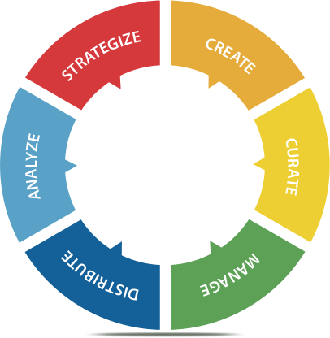




Slide 20
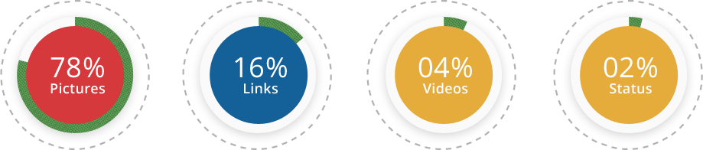
With The Most Shared Content Being..

Slide 21

Here’s Something Good To Know!
60% of consumers enjoy reading relevant content from brands.
82% of consumers feel more positive about a company after reading custom content.
70% of consumers feel closer to a company as a result of content marketing.
Notes:
更多模版：亮亮图文旗舰店https://liangliangtuwen.tmall.com

Slide 22


Slide 23

Gather Topics!
Before you start creating your content plan and strategy, it’s always better to research and shortlist a handful of topics that are not just relevant to your business, but also trending in your circles.
Talking about “what’s in” helps you keep your audience hooked.更多模版：亮亮图文旗舰店https://liangliangtuwen.tmall.com

Slide 24

Tell Your Story!
People want to know the thought process behind your business and how it came about to be. Share your story and your unique experiences along the way. It makes your business more relatable.

Slide 25

Swayy
Its a tool that analyzes your social community, matches the most relevant content from around the web and offers it on your dashboard,
helps you build a relationship between your content and your followers.
Swayy
Notes:
更多模版：亮亮图文旗舰店https://liangliangtuwen.tmall.com

Slide 26
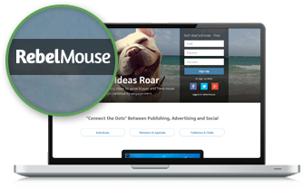
RebelMouse
Claimed as the front page of social media,
helps you curate content for all your online profiles on a single dashboard based on what your business is known for and what conversations your audience has been engaging in.
RebelMouse
Notes:
更多模版：亮亮图文旗舰店https://liangliangtuwen.tmall.com

Slide 27

Social Mention
is a tool capable of scanning the web and producing statistics based on real time buzz around a business. It provides insights on who is talking about your keyword and how often people are engaging in conversations related to you.
Social Mention

Slide 28
谢谢大家

